Slide 1

Translation of Boolean Statements

Slide 2
Boolean Expressions
It has two primary functions
Used as conditional expressions in statements that alter the flow of control. (eg) if-else
Used to compute logical values
It is composed of boolean operators and,or and not applied to boolean variables or relational expressions.
Relational expression is of the form E₁ relop E₂ where E₁ and E₂ are arithmetic expressions.

Slide 3
Cont…
Assume a grammar that generates restricted form of expressions
E → E or E | E and E | not E | (E) | id | id relop id
where relop is <, <=, =, ≠, >, >=
or, and are left associative
or has the lowest precedence than and, not

Slide 4
Methods of Translating Boolean Expression
Two Methods
Method 1 : Numerical Representation
Method 2 : Control –flow representation
Method 1:
To encode true and false numerically and evaluate a boolean expression
1 is used to denote true and 0 denotes false
Non-negative → true
Negative → False

Slide 5
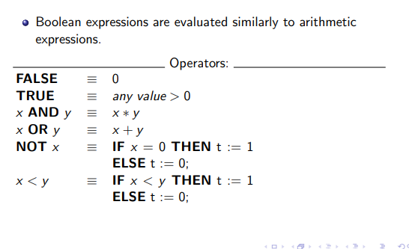

Slide 6
Expressions are evaluated from left to right similar to arithmetic expression
(eg) A or B and C
Three address sequence
T₁ = B and C
T₂ = A or T₁

Slide 7
Relational expression like A<B is equivalent to if A<B then 1 else 0
(1) if A<B goto (4)
(2) T := 0
(3) goto (5)
(4) T :=1
(5)

Slide 8
A<B or C
if A<B goto (4)
T₁ := 0
goto (5)
T₁ = 1
T₂ = T₁ or C

Slide 9
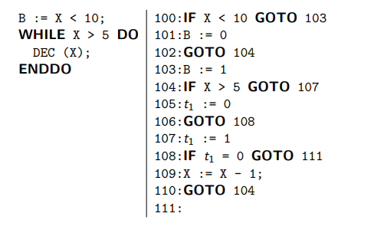

Slide 10
Semantic Rules
E → E⁽¹⁾ or E⁽²⁾
{ T := NEWTEMP();
E.PLACE :=T
GEN ( T:= E⁽¹⁾.PLACE or E⁽²⁾.PLACE)}
E → id⁽¹⁾ relop id⁽²⁾
{T := NEWTEMP();
E.PLACE :=T
GEN ( if id⁽¹⁾ .PLACE relop id⁽²⁾ .PLACE
goto NEXTQUAD+3)
GEN (T := 0)
GEN ( goto NEXTQUAD +2);
GEN (T:=1) }
NEXTQUAD – Next available entry in the quadruple array
GEN – Increments NEXTQUAD after producing a quadruple

Slide 11
Method 2: Control Flow Representation
The position reached in a program is used to represent the value of a boolean expression.
(eg) A or B
If A is true, the entire expression is true without evaluating B

Slide 12
Translation of boolean expression in terms of conditional Statements like,
If E then S⁽¹⁾ else S⁽²⁾
and
while E do S
Two kinds of exits are associated
True exit – to statement TRUE
False exit – to statement FALSE

Slide 13
IF statements
We first generate code for the expression, then the body of the loop.
We put a label (E.true) at the beginning of the loop body. We jump to this label from every place within the expression where we can determine that it is evaluated to true (there may be several such places).
Similarly, we add a label after the end of the statement (E.false) to which we jump when the statement evaluates to false.

Slide 14
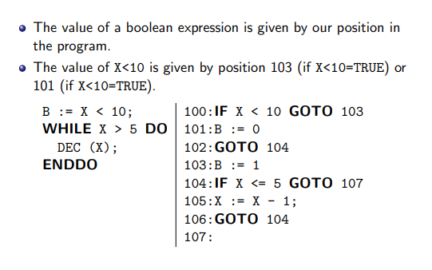

Slide 15
If-statement
Code for E
Code for S⁽¹⁾
TRUE :
Code for S⁽²⁾
FALSE :

Slide 16
While statement
Code for E
Code for S
TRUE :
goto
FALSE :

Slide 17
(eg) IF ( A LT B or C LT D) X = Y+Z
If A < B goto (4)
If C < D goto (4)
goto (6)
T = Y + Z (True Exit)
X = T
(6) (False Exit)

Slide 18
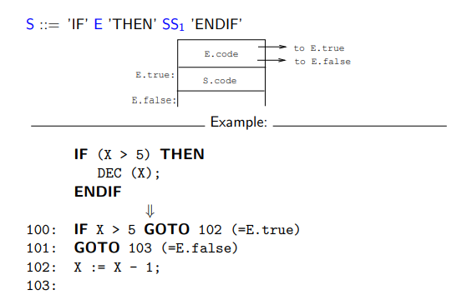

Slide 19
Short circuit Evaluation
What happens if the function f has side-effects (e.g. if it changes the value of a global variable)? Well, in such cases short-circuit code will have different semantics from the non-short-circuit code.
In this example we use flow-of-control for the short-circuit evaluation, and numerical representation for the full evaluation. We could have given both examples using flow-of-control.

Slide 20
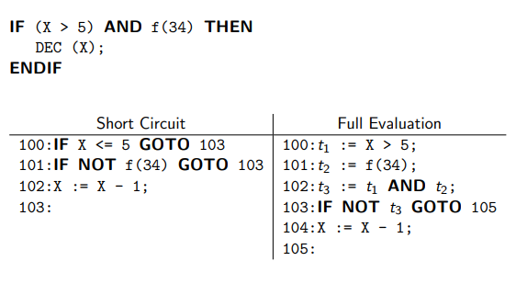

Slide 21
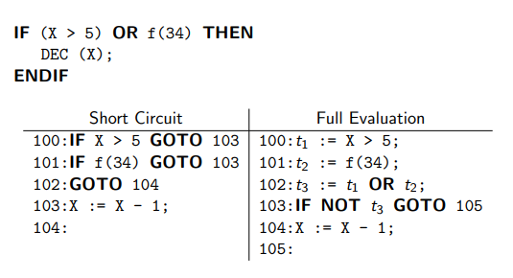

Slide 22
Thank you

